Slide 1
Stress Effects on Statistical Learning
March 9, 2020

Slide 2
Statistical Learning
Statistical Learning = the ability of the brain to extract statistical regularities to learn generalizable rules about the environment
Traditional memory models suggest that this is supported mainly by the cortex
Recent studies demonstrated that the hippocampus can play a role in rapid statistical learning
Temporal communities are predictable relationships about which stimuli are likely to co-occur
Temporal communities can be used implicitly in event segmentation
Shapes with statistical relationships had more similar patterns of activation in fMRI
The hippocampus was necessary for the formation of community representations

Slide 3
Stress and the Hippocampus
Stress impacts a variety of medial temporal functions
Supportive of generalization during encoding
Often obstructive during retrieval
Can induce need for further evidence accumulation
Predictions
Increased performance for encoding group
Decreased performance for retrieval group
Increased lag in response time for the retrieval group
Notes:
Screen capture of the task

Slide 4
Study Goals
Quantify whether and how acute stress impacts statistical learning
Quantify the relationship between performance on temporal community learning tasks and individual differences
Evaluate the relationship between conscious awareness of statistical relationships and demonstrated implicit learning

Slide 5
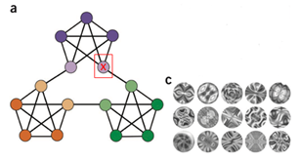
Methodology
Statistical Learning Task
Learning Phase: Subjects see a series of 1400 abstract stimuli, following statistical rules
Retrieval Phase: Subjects see another series of 600 shapes, following the same rules. They are asked to press the spacebar when they feel there is a “natural breaking point” in the sequence
Conscious Awareness Task
Stress Induction Procedure
Salivary Cortisol Measures

Slide 6
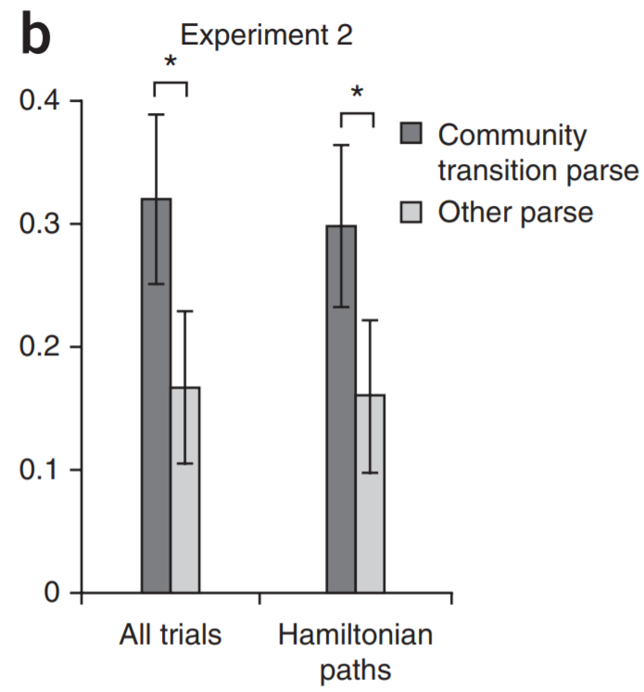
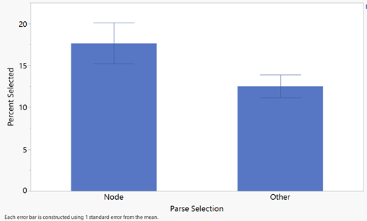
p= 0.038 between node and all other parse selections (for the control group participants specifically)
Trend of implicit learning in control group, though smaller effect than original study

Slide 7
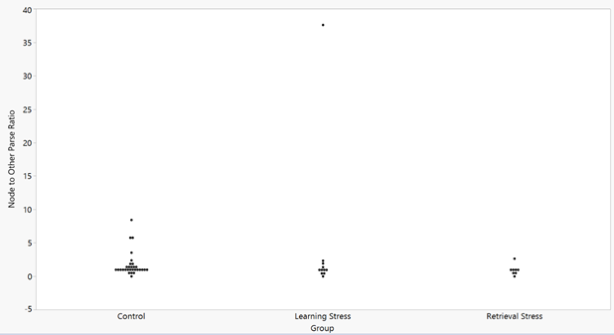
Notes:
This compares the ratio of node parse selections to other parse selections as a way to make people’s responses a single number. The higher the ratio, the better the performance. I am still thinking about what other numbers can be used, as this is not the best measure of performance (since it doesn’t account for overall responses or the relative rarity of node appearance), as well as overinflating outliers as seen in the learning stress group. It appears that the control group may have higher overall performance, but with the limited sample sizes for the stress groups right now, there is not statistical significance.

Slide 8
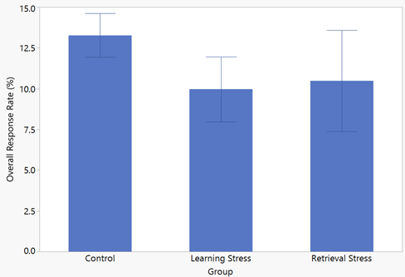
Notes:
Overall response rates of each group in the study. Appears it may be lower in the stress groups, but not statistically significant with the current sample.

Slide 9
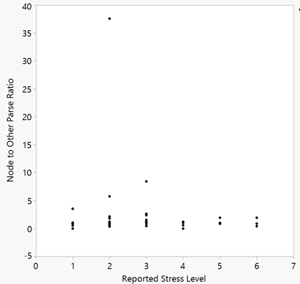
Notes:
Appears that there is no trend between reported stress levels and performance as measured by the node to other parse ratio

Slide 10
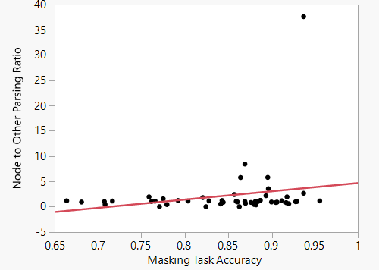
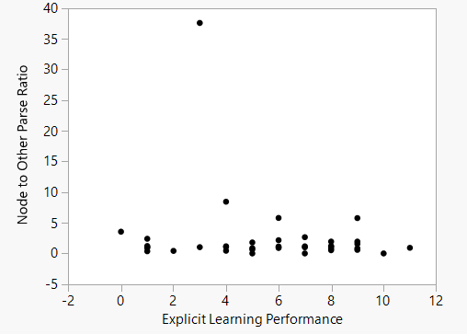
Notes:
Appears that there is no trend between masking task accuracy and performance as measured by the node to other parse ratio
Explicit learning performance as measured by multiple choice questions about the probability of shapes appearing is shown on the right; overall performance was low, as this task was scored out of 24. Appears to be no trend between explicit learning and implicit learning as measured by the node to other parse ratio

Slide 11
Next Steps
Collect larger stress sample
Analyze salivary cortisol data
Develop Mixed Effects Model
Quantify remaining conscious awareness questions and consider other measures of performance

Slide 12
References
1. Schapiro, A. C., Rogers, T. T., Cordova, N. I., Turk-Browne, N. B., & Botvinick, M. M. (2013). Neural representations of events arise from temporal community structure. Nature neuroscience, 16(4), 486.
2. Schapiro, A. C., Turk-Browne, N. B., Botvinick, M. M., & Norman, K. A. (2017). Complementary learning systems within the hippocampus: a neural network modeling approach to reconciling episodic memory with statistical learning. Philosophical Transactions of the Royal Society B: Biological Sciences, 372(1711), 20160049.
3. Schapiro, A. C., Gregory, E., Landau, B., McCloskey, M., & Turk-Browne, N. B. (2014). The necessity of the medial temporal lobe for statistical learning. Journal of cognitive neuroscience, 26(8), 1736-1747.
4. Gagnon, S. A., Waskom, M. L., Brown, T. I., & Wagner, A. D. (2018). Stress impairs episodic retrieval by disrupting hippocampal and cortical mechanisms of remembering. Cerebral cortex (New York, NY: 1991).

